Slide 1
Computer Music
Jack Dangremond

Slide 2
Overview
Algorithmic composition
Computer Accompaniment

Slide 3
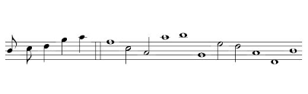
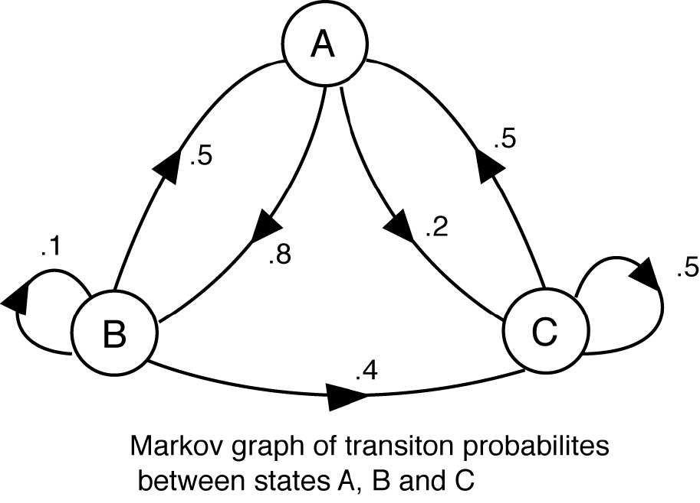
Markov Chains
https://www.youtube.com/watch?v=Cbb08ifTzUk

Slide 4
Natural Phenomenon
https://www.youtube.com/watch?v=i3tiuGVDDkk
https://www.youtube.com/watch?v=Zx0n8BsZdrY

Slide 5
Accompaniment
https://www.youtube.com/watch?v=RnjoxwY3RfA&t=49s
https://www.youtube.com/watch?v=J_Z1GSltMPw
https://www.youtube.com/watch?v=z_8wDxOAWBs

